Slide 1

Classification Of Tweets / Messages Using Logistic Regression and Tf-idfVectoriser Enabled with Text-to-Speech
SRM INSTITUTE OF SCIENCE AND TECHNOLOGY
FACULTY OF ENGINEERING AND TECHNOLOGY
DEPARTMENT OF COMPUTER SCIENCE AND ENGINEERING
15CS496L MAJOR PROJECT
Student 1 Reg. No:RA1711003010151
Student 2 Reg. No:RA1711003010265
Batch ID: CSE02650151
Guide name and Designation:
M.Senthil Raja
Associate Professor

Slide 2
Table of contents
Abstract
Introduction
Literature Survey
Inference from the survey
Objective of the Project
Architecture diagram
Modules Description
Novelty in Methodology
Equations, derivation and Algorithms used
Screen shot of the project
Results and Discussions
References
Publication details
Innovation
Percentage of work completed
Highlight of the Project
Tools used
Contribution of the member

Slide 3
Abstract
The aim of the classification model is to filter the large incoming of tweets/messages into ham/spam or authentic/fraud i.e. to differentiate useful from the unwanted.
This Logistic Regression algorithm is used for the classification of tweets/messages into ham/spam.
To increase the accuracy of the model the TF-IDFvectorizer technique is used along with Logistic Regression .
• Further, we are using Word Cloud so that it can be easily observed that what type of tweets are majorly received by an user or an organization i.e. either ham/spam.
• The results obtained are easy to observe and are more efficient to analyze the outputs.

Slide 4
Introduction
Spam twitter messages has become a very serious problem. Sending inappropriate messages to a large number of recipients indiscriminately has resulted in anger by users but large profits for spammers.
In this technology-driven world, daily we use to receive a very large number of emails from various organizations, companies or people around the globe.
Sometimes, it is not possible to read all the emails received. Some of them may be extremely important while some are just for promotions, updates or information which is least important.
We can clearly see how the 2 categories are differentiated.
Spam messages contain : call, now, claim, free, txt, guaranteed
Ham messages contain : good, later, home, sorry, need, come

Slide 5
An tweet/messages classification system is a framework that is intended to screen the continuous progression of messages in an association or in an individual record.
Via naturally exploring and looking through the substance present in the body of the messages and in any connections, the framework will group each messages into different classes as requested by an organization or by a person.
This spares time just as odds of mistakes and besides it diminishes the representative expense to an organization.

Slide 6
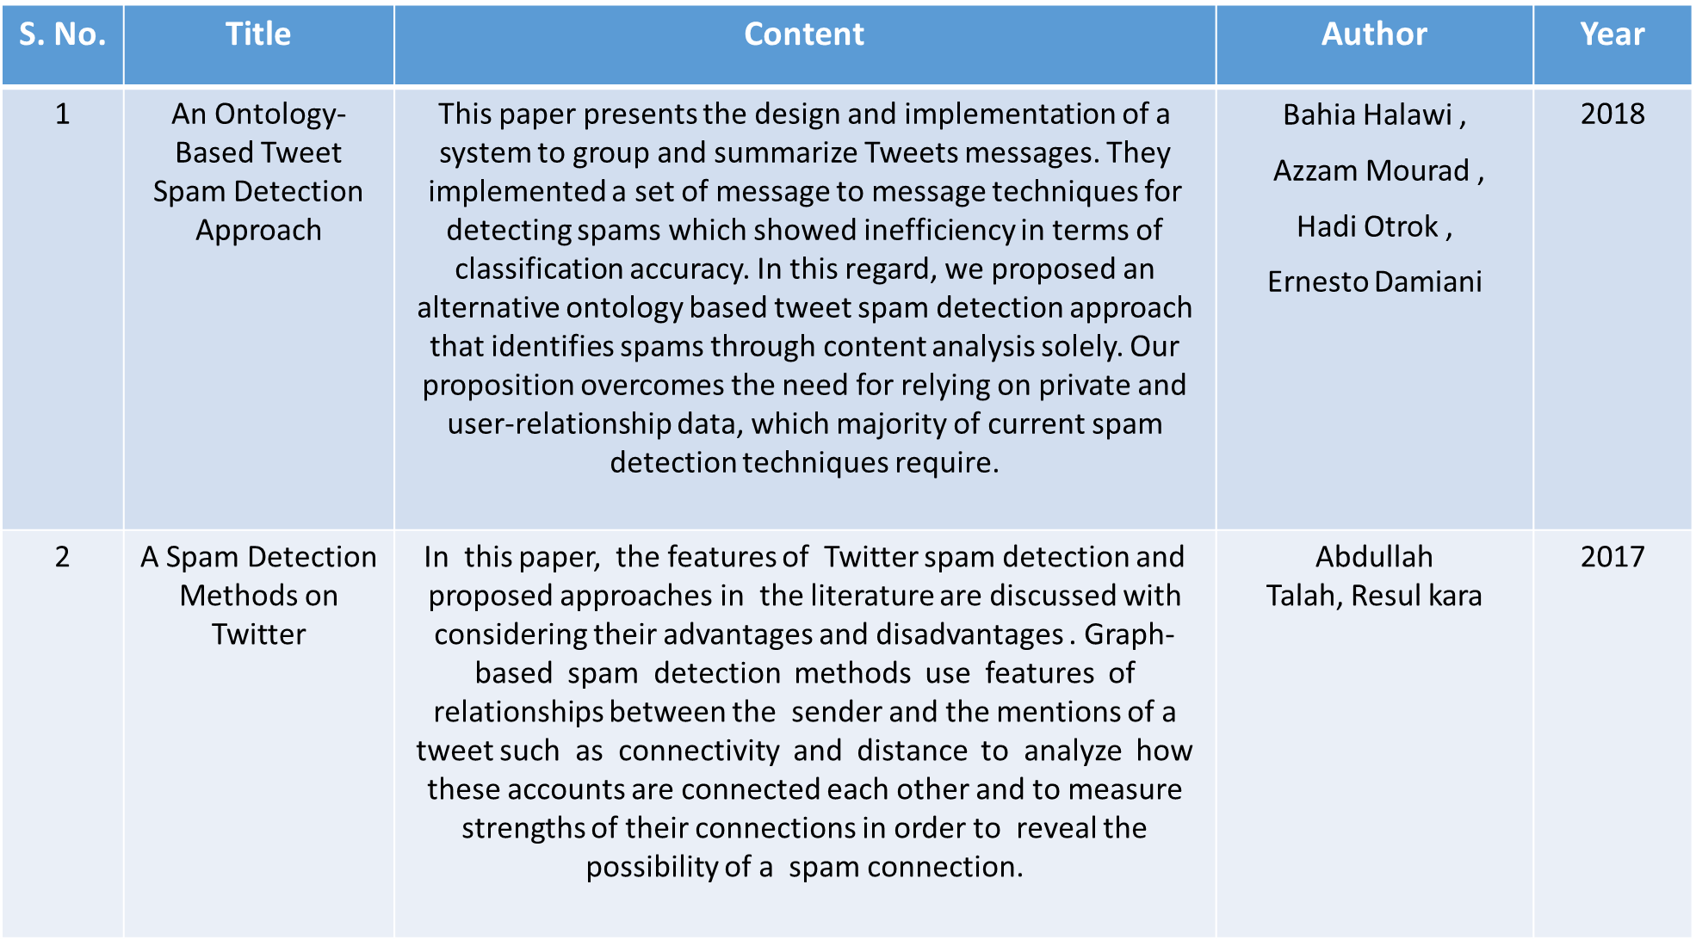
Literature Survey

Slide 7
S. No. | Title | Content | Author | Year
3 | A Framework for Real-Time Spam Detection in Twitter | In this paper, They give a framework based on different machine learning approach that deals with various problems including accuracy shortage, time lag(BotMaker) and high processing time to handle thousands of tweets in 1 sec. This technique is proﬁcient for spam detection in real-time. | Himank Gupta, Mohd. Saalim Jamal, Sreekanth Madisetty and Maunendra Sankar Desarkar | 2018
4 | Twitter Sentiment Analysis | It has been classified using Deep convolution Neural Network. It was able to achieve only one set of accuracy model of using SVM as a unigram model. Tweets are usually composed of incomplete expression, a variety of noise and poorly structured sentences because of the frequent presence of acronym, irregular grammar, ill- formed words and non-dictionary terms. | M. Gayathri, S. Shajun Nisha, M. Mohamad Sathik | 2020
5 | Surface and Deep Features Ensemble for Sentiment Analysis of Arabic Tweets | The recent language representation model BERT is also evaluated on the task of SA of Arabic tweets. The models are evaluated on three different datasets of Arabic tweets, and they outperform the previous results on all these datasets with a significant increase in the F-score. The experimental results demonstrate that: 1) the highest performing model is the ensemble of surface and deep features and 2) the approach achieves the state-of-the-art results on several benchmarking datasets. | Nora Al-Twairesh; Hadeel Al-Negheimish | 2019

Slide 8
S. No. | Title | Content | Author | Year
6 | Machine learning methods for personalized email prioritization. | They focus on three aspects: 1) we investigate how to express the ordinal relations among the priority levels through classification and regression. 2) we analyze personal social networks to capture user groups and to obtain rich features that represent the social roles from the view point of a particular user. 3) We also develop a semi-supervised (trans-ductive) learning algo that propagates importance labels from training examples to test examples through messages and user nodes in a personal email network | Yoo, S Ph.D. Carnegie Mellon University | 2010
7 | Spam filtering email classification (SFECM) using gain and graph mining algorithm | This paper proposes a hybrid solution of spam email classifier using context based email classification model as main algorithm complimented by information gain calculation to increase spam classification accuracy. Proposed solution consists of three stages email pre-processing, feature extraction and email classification. Research has found that Linger IG spam filter is highly effective at separating spam emails from cluster homogenous work emails. | M. K. Chae; Abeer Alsadoon; P.W.C. Prasad; Sasikumaran Sreedharan | 2017
8 | A comparative approach to email classification using Naive Bayes classifier and hidden Markov model | This research investigates a comparison between two different approaches for classifying emails based on their categories. Naive Bayes and Hidden Markov Model (HMM), two different machine learning algorithms, both have been used for detecting whether an email is important or spam. Naive Bayes Classifier is based on conditional probabilities. It is fast and works great with small dataset. It considers independent words as a feature. | Sebastian Romy Gomes; Sk Golam Saroar; Md Mosfaiul; Alam Telot; Behroz Newaz Khan; Amitabha Chakrabarty( | 2017

Slide 9
S. No. | Topic | Content | Author | Year
9 | Countvectorizer Enabled Email Classification Using Logistic Regression and Wordcloud System | In this system, the algorithm is used to get results more accurately and efficiently. This logistic regression algorithm with countvectorizer is used for the classification of emails into ham or spam. Further, we are using word cloud so that it can be easily observed that what type of emails are majorly received by a user or an organization i.e. either ham emails or spam emails. | Akash Mal, Shivang Saini | 2020
10 | Kannada text to speech conversion: A novel approach | Conversion of linguistic scripts to speech will help in improving the lives of people who are unable to read. According to literature survey conversion of English text to speech has been attempted by several researchers, however, there is less research in speech synthesis of local languages. In this paper, the authors propose an algorithm to translate Kannada language text to speech. Here, direct concatenation of speech coefficients extracted from prerecorded voice is used for conversion. The proposed algorithm is also compared with another speech synthesizer which is widely used, to evaluate its performance. | M. S. Dhananjaya; B. Niranjana Krupa; R. Sushma | 2016

Slide 10
Inference from the survey
The inference from the survey is that the high accuracy can be obtained only by involving multiple algorithms in a tweet/message classification system.
But by involving multiple algorithms in a tweet/message classification time to classify the tweets/messages increased. Although for small dataset time taken is quite small but for large datasets, the time taken is very high.
So, to avoid that issue there is a need to develop such an algorithm or should make those changes in the present algorithm so that the time of classification can be reduced.

Slide 11
Objective of the Project
To make classification more accurate with high precision.
To make a certain little contribution to society with our little project.
To make a system that saves users time and increases efficiency.
To make a system which assists in highlighting messages from approved and unapproved research providers and reports unapproved research.

Slide 12
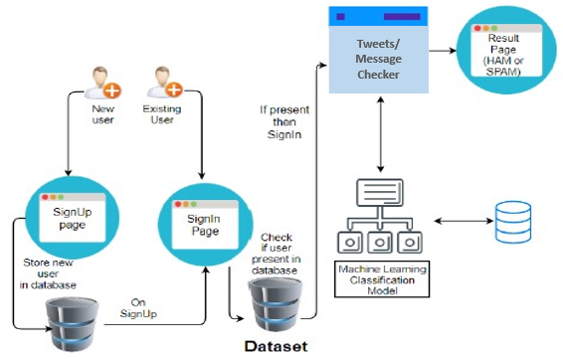
Architecture diagram
Client-Server Architecture Diagram of Tweet/Message Classification System

Slide 13
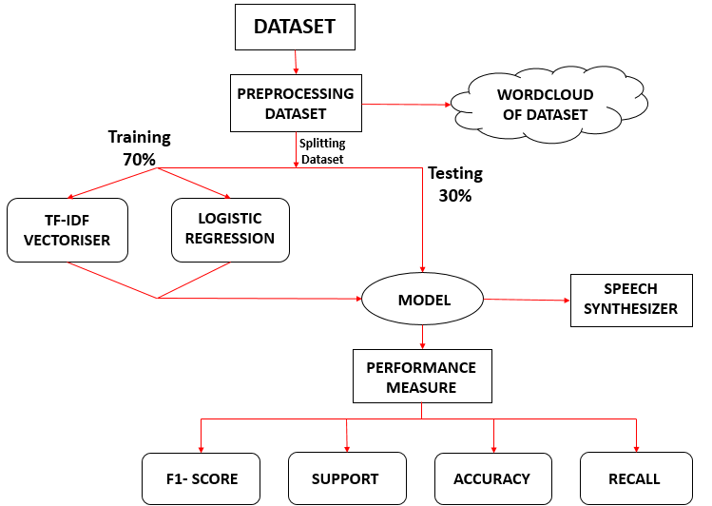
Architectural Diagram for Model Preparation Using Logistic Regression for Tweet/Message Classification

Slide 14
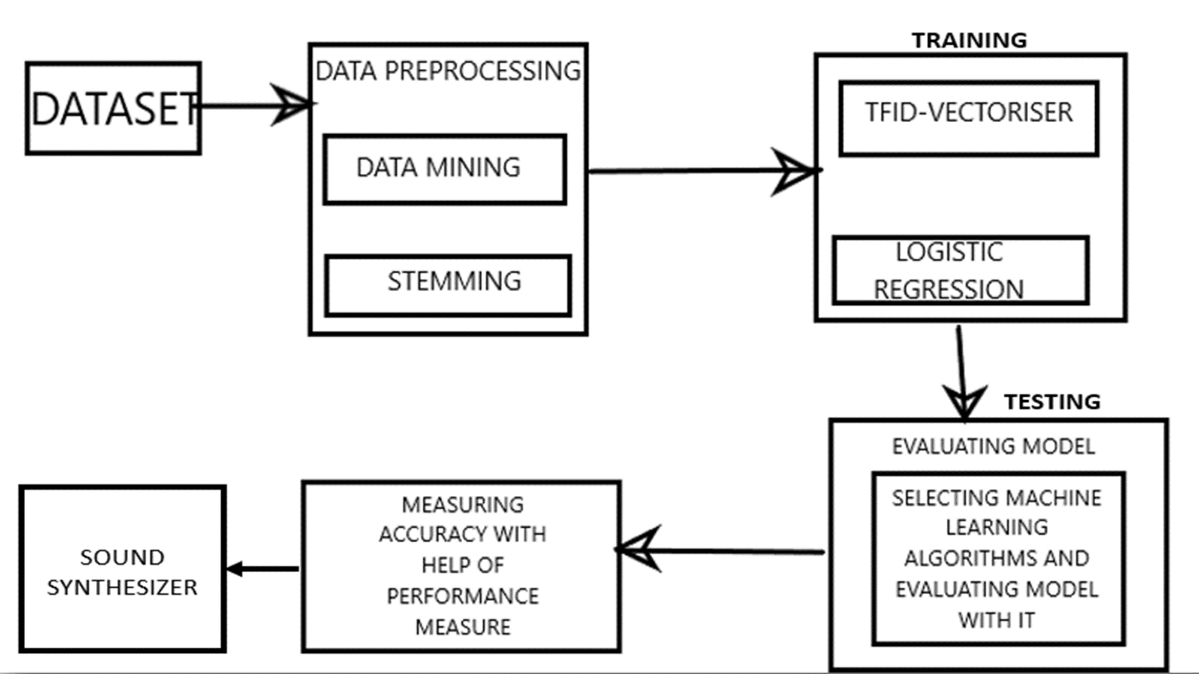

Slide 15
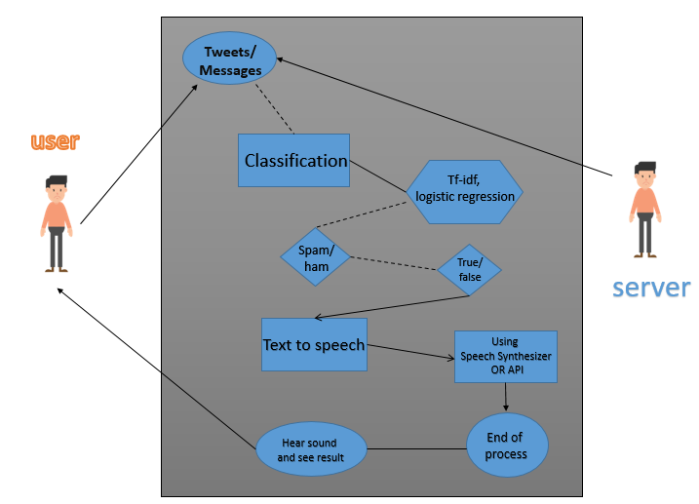
Uml-diagram

Slide 16
Modules Description
Data Preparation
Any algorithm in machine learning, be it regression or classification needs a dataset to perform its necessary function. So, priority should be given to a hundred percent retrieval of tweet/message from the server, irrespective of their domain. The dataset is retrieved from open-source ends to apply the algorithm.
Once the tweet/message retrieval from the corpus is successfully finished, it is sent to the application. Now, only the issue of classification is done by scanning the text of each tweet/message, which includes the body as well as the type

Slide 17
Analysis of Data
The accuracy is directly proportional to the training the dataset receives but has to be careful so that the machine is not over trained. Further analysis of the result obtained after training needs to be surveyed. These provide an insight into the: ‘outlier’.
The outlier divides the dataset into malicious and important data. The proper data which is obtained from the outliers are the ones that will be assessed further

Slide 18
Logistic Regression
The logistic regression model is trained by using an algorithm known as gradient ascent, based on the idea of maximum likelihood. However, logistic regression is too expensive mostly for the heavy and huge dataset and the accuracy is compromised because of this. And the complexity of the iterative algorithm is reduced by the stochastic gradient ascent algorithm
Tfidfvectorizer
At Information Retrieval, TF-IDF (short term for TERM FREQUENCY–INVERSE DOCUMENT FREQUENCY) is a numeric statistics that’s intended to reflect that how important is a word to Document inside a Collection.

Slide 19
Final Assessment
Finally, before the output is shown, it needs to be assessed for the last time. Then this is classified or filtered. The dataset has been trained on the algorithm we require. The real-time result can be obtained by retrieving the user’s emails.
The accuracy can be optimized by comparing the outcome with the real-time results. The parameters are further retained for the algorithm.

Slide 20
WordCloud
WordCloud is a technique to show which words are the most frequent among the given text. The first thing you may want to do before using any functions is check out the docstring of the function, and see all required and optional arguments.
Word cloud (otherwise called text clouds or tag clouds) is a method of depicting the word as indicated by their recurrence. It shows the size of the word according to frequency of the word present in the collection.
Benefits of word cloud-
• Word clouds are straightforward and give clearness.
• Word clouds are a ground-breaking specialized apparatus.
• Word clouds are outwardly appealing than plain information.

Slide 21
Novelty in Methodology
The survey concluded that previous papers had never actually addressed the trade off between speed and accuracy.
This project compares and selects the most efficient algorithm.
This method involves the usage of dynamic data.
With the use of a word cloud the visualization is vivid and easily characterizes the organizations volumes of emails.

Slide 22
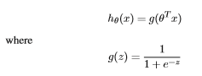
Equations, derivation and Algorithms used
1)Logistic regression :
Logistic regression is a statistical model that in its basic form uses a logistic function to model a binary dependent variable
The logistic regression model is trained by using an algorithm known as gradient ascent, based on the idea of maximum likelihood.

Slide 23
However, the complexity of the iterative algorithm is reduced by the stochastic gradient ascent algorithm.
It is also used for logistic regression model optimization which results in improving the iterative algorithm by decreasing the periodic fluctuation.
To reduce the complications, a stochastic gradient ascent algorithm is generally used for logistic regression model optimization.
These days many recommendation systems use the logistic model.

Slide 24
2) TFIDF-Vectorizer :
In Information Retrieval, TF-IDF (short for TERM FREQUENCY–INVERSE DOCUMENT FREQUENCY) is a numerical statistics that is intended to reflect how important a word is to a Document in a Collection.
TF(t) = (Number of times term t appears in a document) / (Total number of terms in the document).
IDF: Inverse Document Frequency, which measures how important a term is.
WE WILL USE TF-IDF VECTORISER() AS
THE ADAVANTAGE WILL BE IT WILL GIVE SCORES FOR HOW MUCH TIMES A WORD IS APPEARED IN SENTENCE. SO IT GIVES A FLOAT VALUE IN MATRIX AS VECTOR.

Slide 25
3)WordCloud :
Shows the frequency of the words the dataset contains .The more the frequency of the word the more larger the size of the word .
Word cloud (otherwise called text clouds or tag clouds) is a method of depicting the word as indicated by their recurrence. It shows the size of the word according to freq-uecy of the word present in the collection.

Slide 26
4)Text-To-Speech:
Speech synthesis is the artificial production of human voice.
-A computer system used for this task is called a speech synthesizer.
-The main aim of text-to-speech (TTS) system is to convert normal language text into speech.
-Synthesized speech can be produced by concatenating pieces of recorded speech that are stored in a database.
-In case of illiterate people Voice is a better interface rather than Graphic User Interface in English.
-For that reason research is being done through out the world for improving the Human Interface to the computer and one of the best options is the ability of a computer to speak to humans.
-Text-To-Speech is a process in which input text is first analyzed, then processed and understood, and then the text is converted in digital audio and then “spoken”.

Slide 27
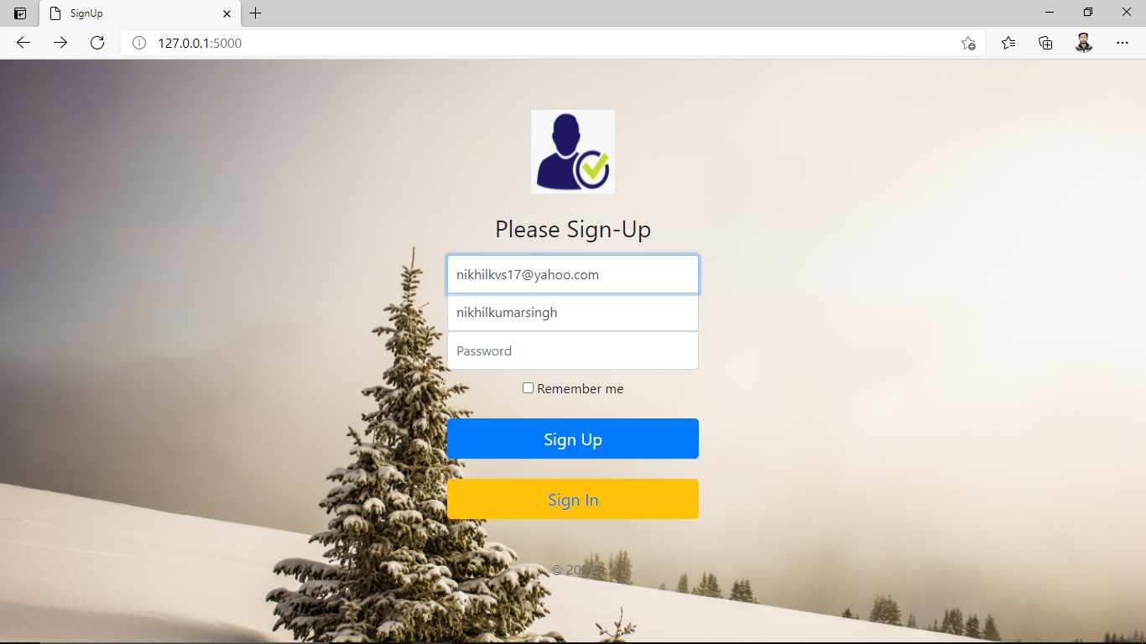
Screenshots of the project

Slide 28
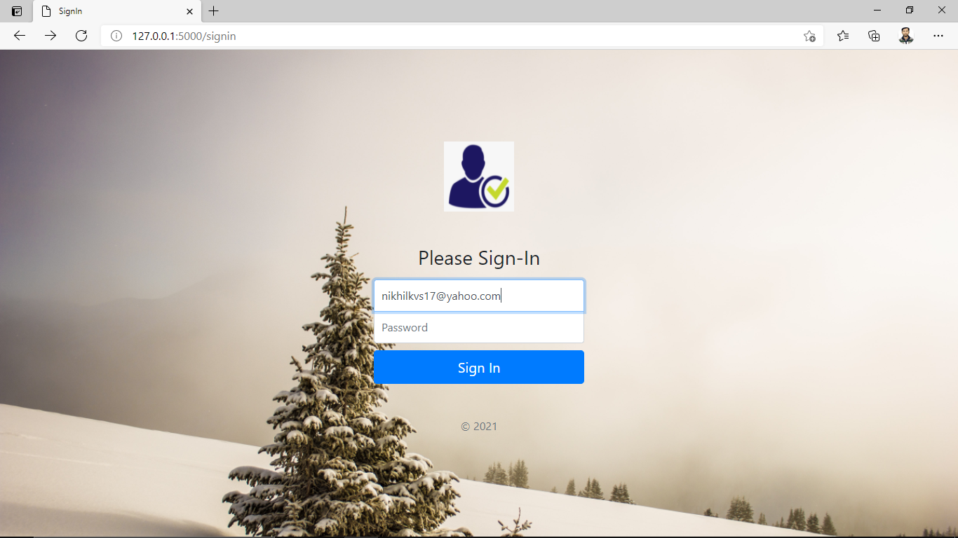
SignIn

Slide 29
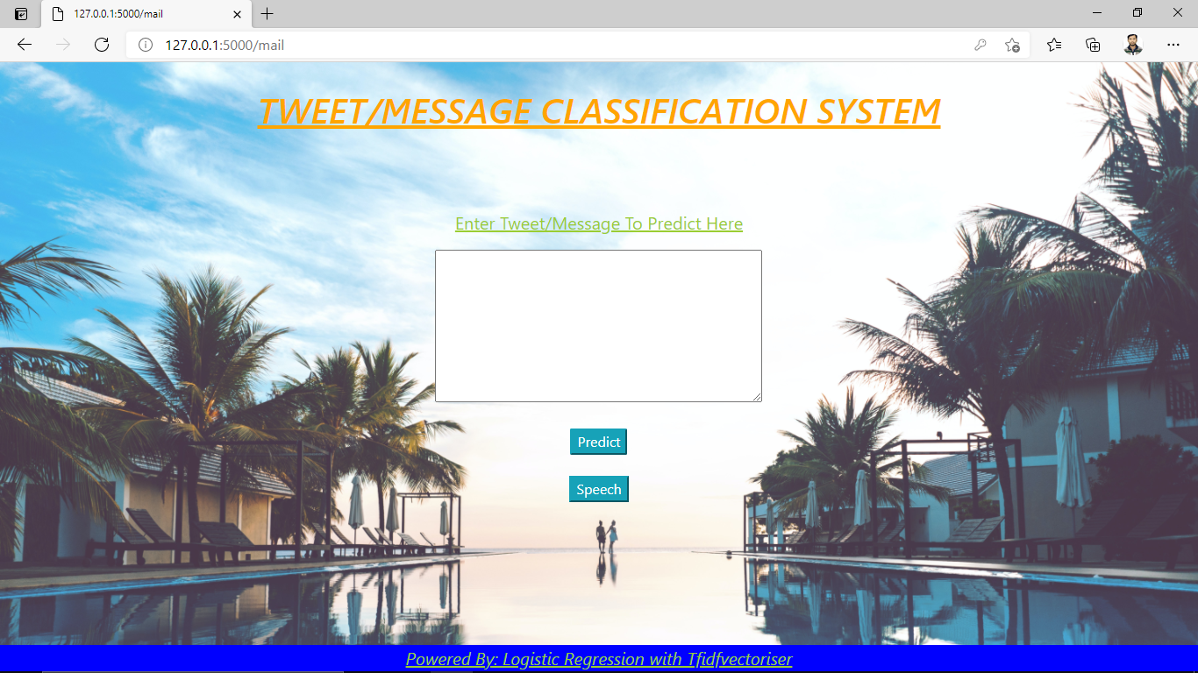

Slide 30
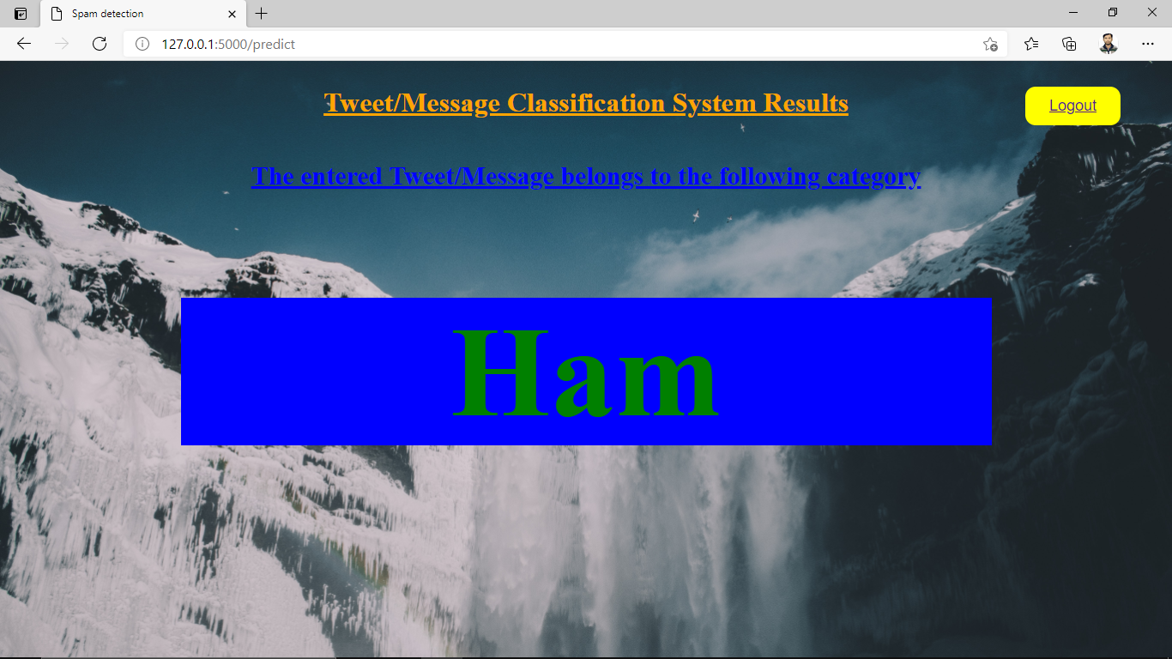

Slide 31


Slide 32
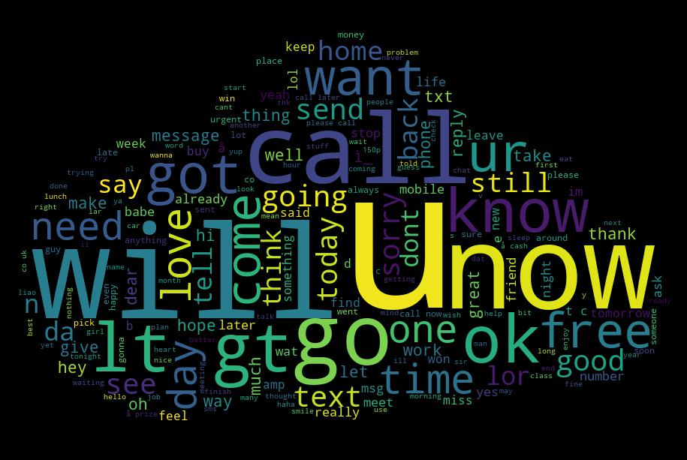
Word Cloud

Slide 33
Results and Discussions
In this model using TfidfVectorizer along with Logistic Regression, we are getting the accuracy of 97% for classifying Tweet/Message into ham and spam.
In this model, we are getting an F1-score of 0.98 for ham and 0.86 for spam.
Moreover, recall value for ham is 0.96 and for spam, recall value is 0.99
This system has considerably able to give the best the trade of between speed and accuracy.
Saves lot of time for users and gives an insight about the emails users receives on a day to day basis.

Slide 34
References
Bahia Halawi,Azzam Mourad ,Hadi Otrok ,Ernesto Damiani ; An Ontology-Based Tweet Spam Detection Approach ; Year-2018
Abdullah Talah, Resul kara ; A Spam Detection Methods on Twitter ; Year-2017
Himank Gupta, Mohd. Saalim Jamal, Sreekanth Madisetty and Maunendra Sankar Desarkar ; A Framework for Real-Time Spam Detection in Twitter ; Year-2018
M. Gayathri, S. Shajun Nisha, M. Mohamad Sathik ;Twitter Sentiment Analysis ; Year-2020
Nora Al-Twairesh; Hadeel Al-Negheimish ; Surface and Deep Features Ensemble for Sentiment Analysis of Arabic Tweets ; Year-2019
Yoo, S Ph.D. Carnegie Mellon University ; Machine learning methods for personalized email prioritization: year-2010
Sasikumaran Sreedharan,Abeer Alsadoon,P.W.C. Prasad,M. K. Chae;Spam filtering email classification (SFECM) using gain and graph miningalgorithm;Year(2017)

Slide 35
B.NiranjanaKrupa, M.S.Dhananjaya;R. Sushma;Kannada text to speech conversion: A novel approach,IEEE-2016
Sebastian Romy Gomes,Sk Golam Saroar,Md Mosfaiul,Alam Telot,Behroz Newaz Khan,Amitabha Chakrabarty ; A comparativeapproach to email classification using Naive Bayes classifier and hidden Markov model ; Year-2017
P Punde,R Wagh;Survey on sentimentanalysis using twitterdataset : Year(2018)
P Rosso,E Fersini,M.Anzovino;Automatic identification and classificationof misogynistic languageon twitter; Year(2018)
AlexHaiWang;machine learning forthe Detection of SpaminTwitter Networks, springer; Year(2012)
S Nepal,R Nugroho,J Yang,C Paris; A survey ofrecent methodson deriving topicsfrom Twitter: algorithm toevaluation; Year(2020)
V Kharde, P Sonawane ;Sentiment analysis of twitter data: a survey of techniques-2016

Slide 36
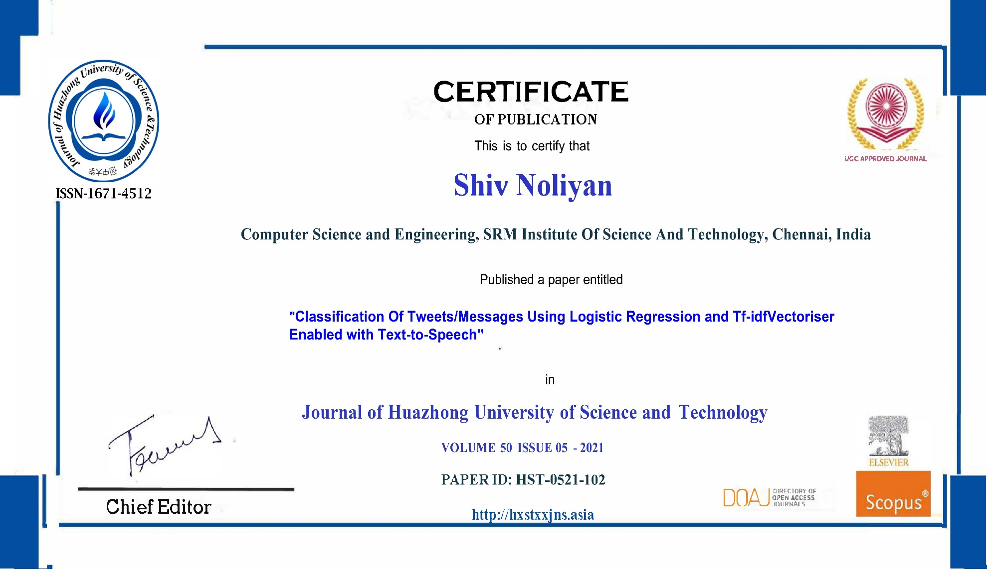
Publication details

Slide 37
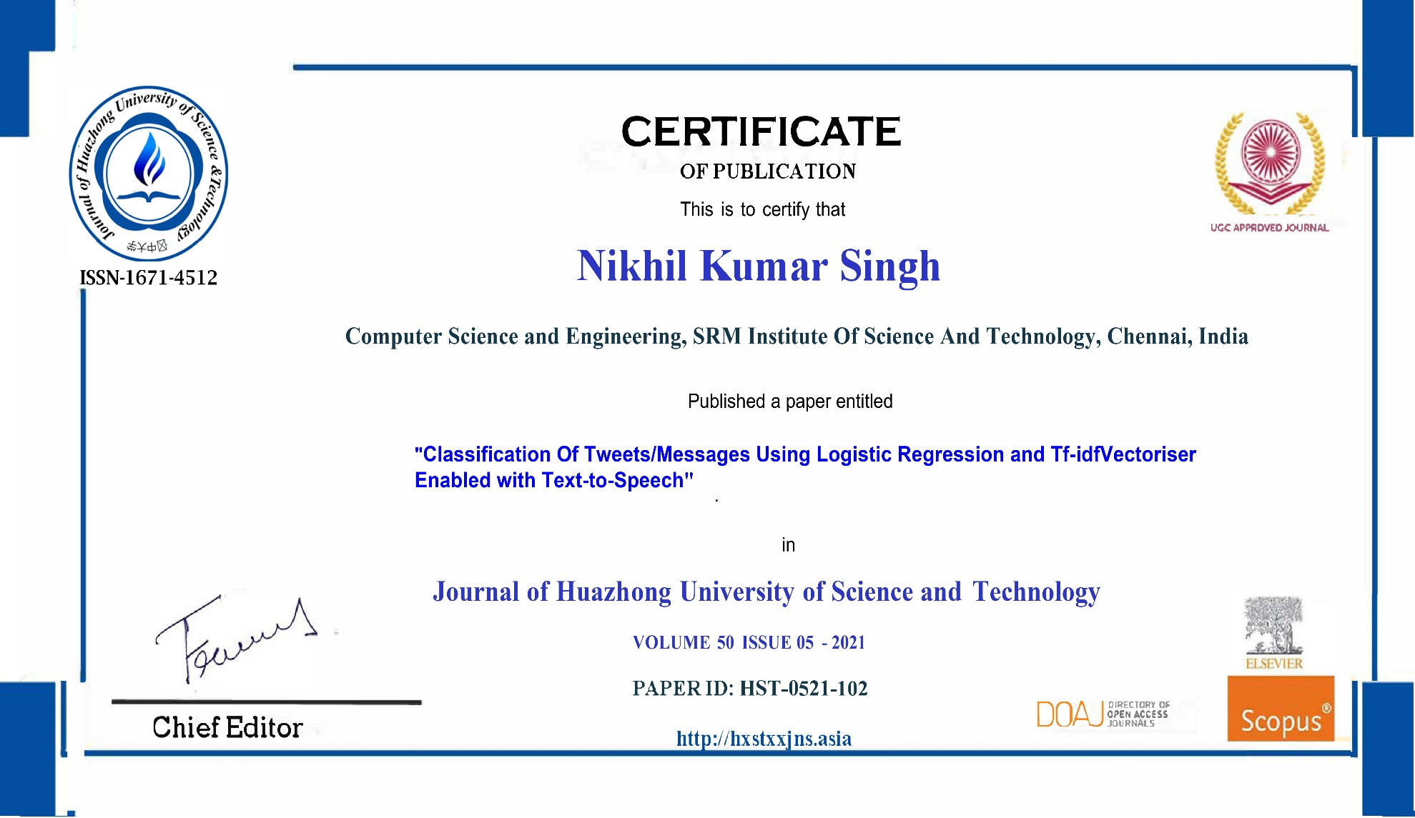
Publication details

Slide 38
Innovation
There has been quite a few Machine Learning algorithms that have quite sorted the tweets/message. They lacked accuracy if they used a single algorithm. When used multiple algorithms they were heavy and needed time for computation.
To make something an efficient and simple algorithm for matching words in a query to documents that are relevant to the query and returns documents that are highly relevant to a particular query.
To make something that is more accurate than previous project and try to get desired result in less time too.
To get the same output with a different approach which not only saves time but also précised and subtle in nature.
Using text to speech for better user experience.

Slide 39
Percentage of work completed (during submission of project report)
We have finished almost all of the work.
We had completed the whole project during the submission of the project report with the proper integration.
There were some things left such as validation that we were creating for the demonstration of the project.
After we had submitted the project report we went on ahead and made the required changes.
Currently the whole project is ready with 100% working efficiency.

Slide 40
Highlight of the Project
Rather than traditional ways included only single algorithms which provides high accuracy in less time.
The models which included multiple algorithms had a reduced speed and more complexity.
The project uses Logistic regression enabled with TfidfVectorizer technique.
The time and accuracy trade off has been handled with accuracy of 97%.
The method of TfidfVectorizer is easy to implement and has an unbiased classification.

Slide 41
Tools Used (mathematical, software etc.)
1. Hardware Requirements
Any normal home PC (laptop or desktop) will suffice as a client as long as it can compile and run python files and has a relatively decent internet connection. i.e. The minimum requirements are:
• 4 GB RAM
• 1 GB HDD space (mainly to store the data set)
• 1 Mbps internet connection
2. Software Requirements
Python 3.7
Anaconda (Python Distribution)
3. Mathematical Requirements
Tools (an online website to perform calculus and algebra)

Slide 42
Contribution of each member
Shiv Noliyan :
The integration of TfidfVectorizer with multiple algorithms like logistic regression
this increased the accuracy of model to 97%.
Helped to figure out best dataset for the models from different datasets.
Helped in editing research paper and publishing it.
Crucial part in preparing the project report and documentation.
Suggested easy methods to perform sentiment analysis of user using WordCloud.
Nikhil Kumar Singh :
The designing of the project with the data flow and data extraction.
This facilitated the successful extraction of 100% data and proper result of unbiased data.
Designing a easy and secure UI to use tweet/message classification system and showing results.
Crucial part in making and suggesting architecture of the project and suggesting methods like TfidfVectorizer.
Research paper writing and formatting.
Provided formatting for the project report.

